Slide 1
Chapter 7: Internal Control and Cash
Financial & Managerial Accounting, 16e

Slide 2
Sarbanes-Oxley Act (Learning Objective 1)
The purpose of the Sarbanes-Oxley Act is to maintain public confidence and trust in the financial reporting of companies.
Sarbanes-Oxley applies only to companies whose stock is traded on public exchanges, referred to as publicly held companies.
Sarbanes-Oxley emphasizes the importance of effective internal control.
The objectives of internal control are
provide reasonable assurance that assets are safeguarded and used for business purposes,
business information is accurate,
and laws and regulations are complied with

Slide 3
Internal Control (Learning Objective 2)
Internal Control—Integrated Framework is the standard by which companies design, analyze, and evaluate internal control.
objectives of internal control include
provide reasonable assurance that assets are safeguarded and used for business purposes,
business information is accurate, and
laws and regulations are complied with
A serious concern of internal control is preventing employee fraud.
Employee fraud is the intentional act of deceiving an employer for personal gain.

Slide 4
Elements of Internal Control
The control environment is the overall attitude of management and employees about the importance of controls.
Risk Assessment :Management should identify such risks, take any necessary actions to minimize them.
Control procedures: provide reasonable assurance that business goals will be achieved, including the prevention of fraud.
Monitoring: the internal control system is used to locate weaknesses and improve controls.
Information and Communication: used by management for guiding operations and ensuring compliance with reporting, legal, and regulatory requirements

Slide 5
Bank Accounts (Learning Objective 4)
A major reason that companies use bank accounts is for internal control.
Some of the control advantages of using bank accounts are as follows:
Bank accounts reduce the amount of cash on hand.
Bank accounts provide an independent recording of cash transactions.
Reconciling the balance of the cash account in the company’s records with the cash balance according to the bank is an important control.
Use of bank accounts facilitates the transfer of funds using EFT systems.

Slide 6
Bank Statement (1 of 4)
Banks maintain a record of all checking account transactions.
A summary of all transactions, called a bank statement, is mailed, usually each month, to the company (depositor) or made available online.
The bank statement shows the beginning balance, additions, deductions, and the ending balance.

Slide 7
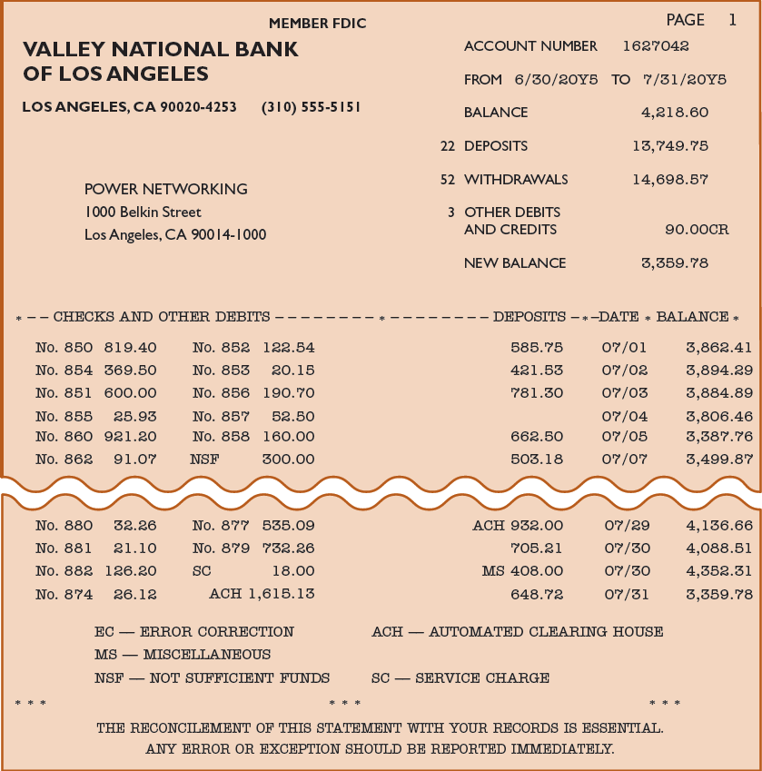
Exhibit 9 – Bank Statement

Slide 8
Bank Statement
The company’s checking account balance in the bank records is a liability. Thus, in the bank’s records, the company’s account has a credit balance.
Because the bank statement is prepared from the bank’s point of view, a credit memo entry on the bank statement indicates an increase (a credit) to the company’s account.
Likewise, a debit memo entry on the bank statement indicates a decrease (a debit) in the company’s account.

Slide 9
Bank Reconciliation (Learning Objective 5)
A bank reconciliation is an analysis of the items and amounts creating the difference between the cash balance reported on the bank statement and the balance of the cash account in the ledger.
The adjusted cash balance determined in the bank reconciliation is reported on the balance sheet.
A bank reconciliation is usually divided into two sections as follows:
The bank section begins with the cash balance according to the bank statement and ends with the adjusted balance.
The company section begins with the cash balance according to the company’s records and ends with the adjusted balance.

Slide 10
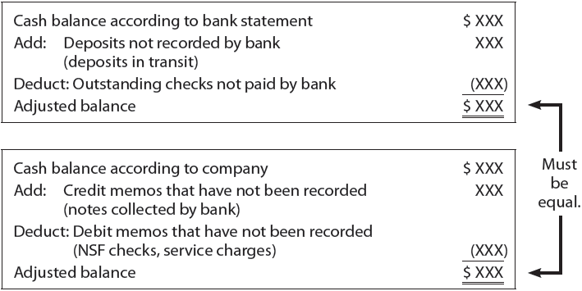
Bank Reconciliation
The adjusted balance from bank and company sections must be equal.
The format of the bank reconciliation follows:

Slide 11
Bank Reconciliation for Power Networking
The bank statement shows a balance of $3,359.78 as of July 31. The cash balance in Power Networking’s ledger on the same date is $2,549.99.

Slide 12
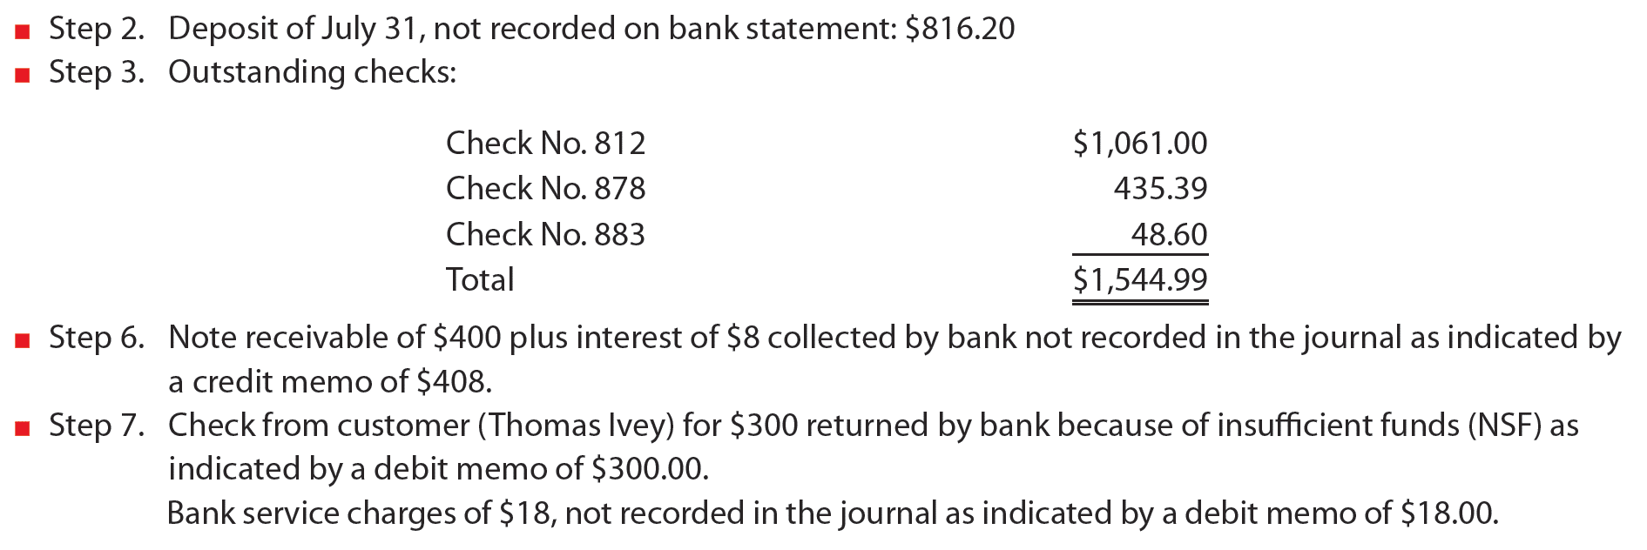
Bank Reconciliation for Power Networking
The following reconciling items were identified:
In addition, Check No. 879 for $732.26 to Taylor Co., on account, was recorded in the company’s journal as $723.26.

Slide 13
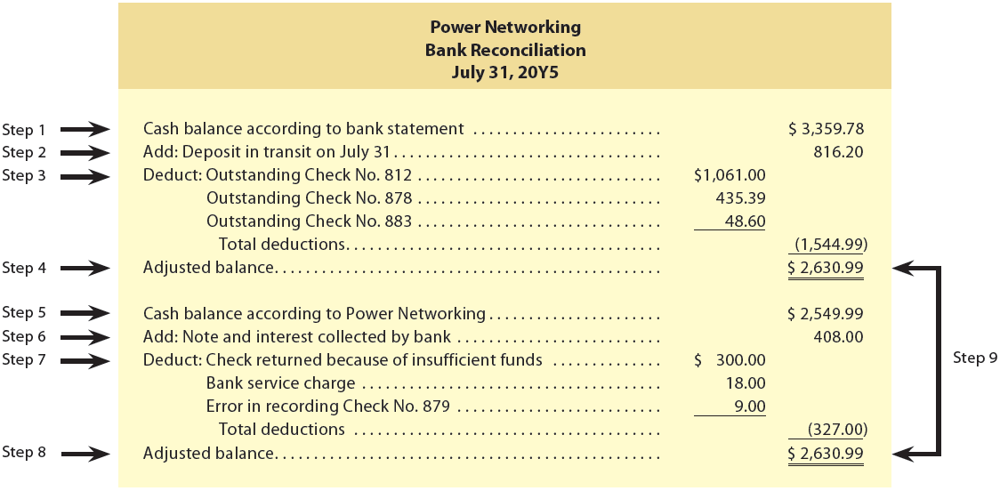
Exhibit 13 – Bank Reconciliation for Power Networking

Slide 14
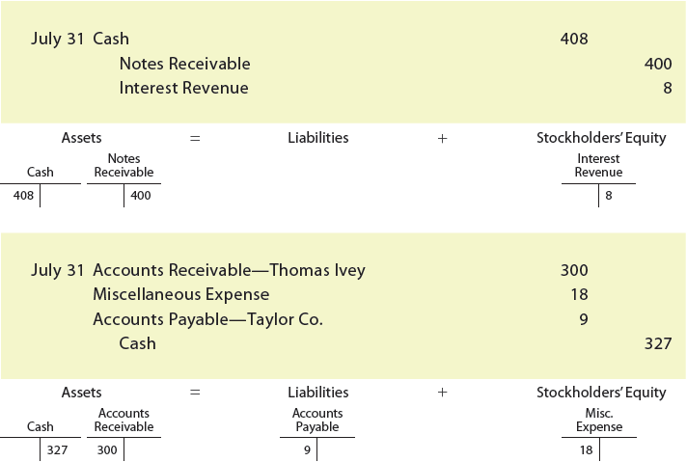
Bank Reconciliation
The journal entries for Power Networking, based on the bank reconciliation shown in Exhibit 13, are as follows:

